Slide 1
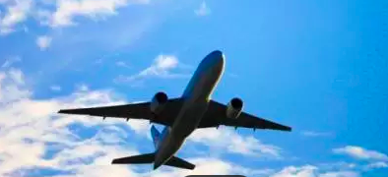
The Effect of Flight Duration on Sales Price: A Regression Analysis
Ibrahim Suleiman
Western Governors University

Slide 2
Introduction – Ibrahim Suleiman
Education
AWS Certification
Certified Supply Chain Specialist CSCS
B.A in Archaeology
M.B.A. in Human Resource Management
Pursuing M.S. in Data Analytics
Professional
Data Analyst
Former B.I Consultant and Logistic Analyst at Multiple Companies
Former Data Analyst Intern at the United Nations

Slide 3
Problem Statement and Hypothesis

Slide 4
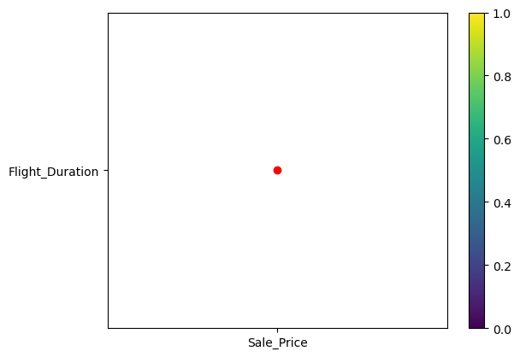
To what extent does the duration of a flight affect its sales price?
Our Problem Statement

Slide 5
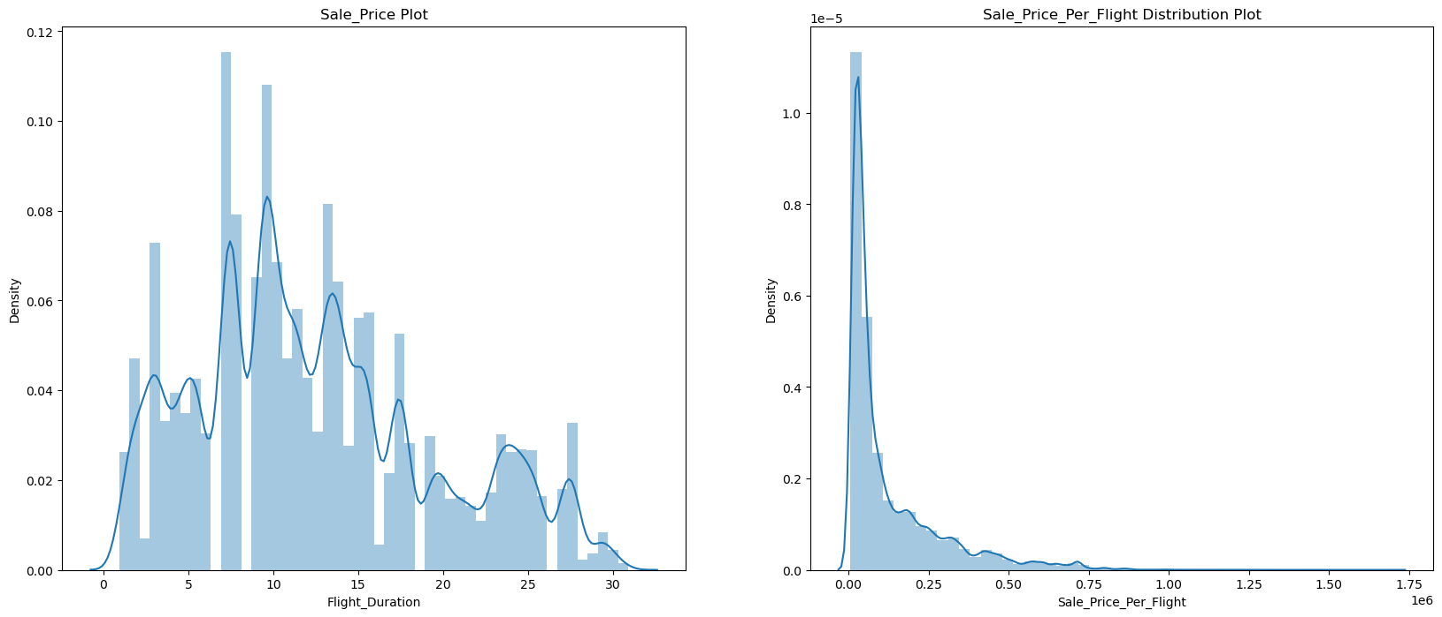
Flight duration appears to be the factor predicting the focal point on sales price

Slide 6
Null hypothesis:
The duration of a flight statistically significantly affects its sales price.

Slide 7
Data Analysis, Limitations, and
Outline of the Findings

Slide 8
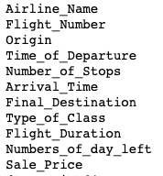
Collected and modified Data from Kaggle
● The modified dataset
● Contains approximately 300,153 data points
● Contains 11 features
● Clean Datasets
Data Dictionary

Slide 9
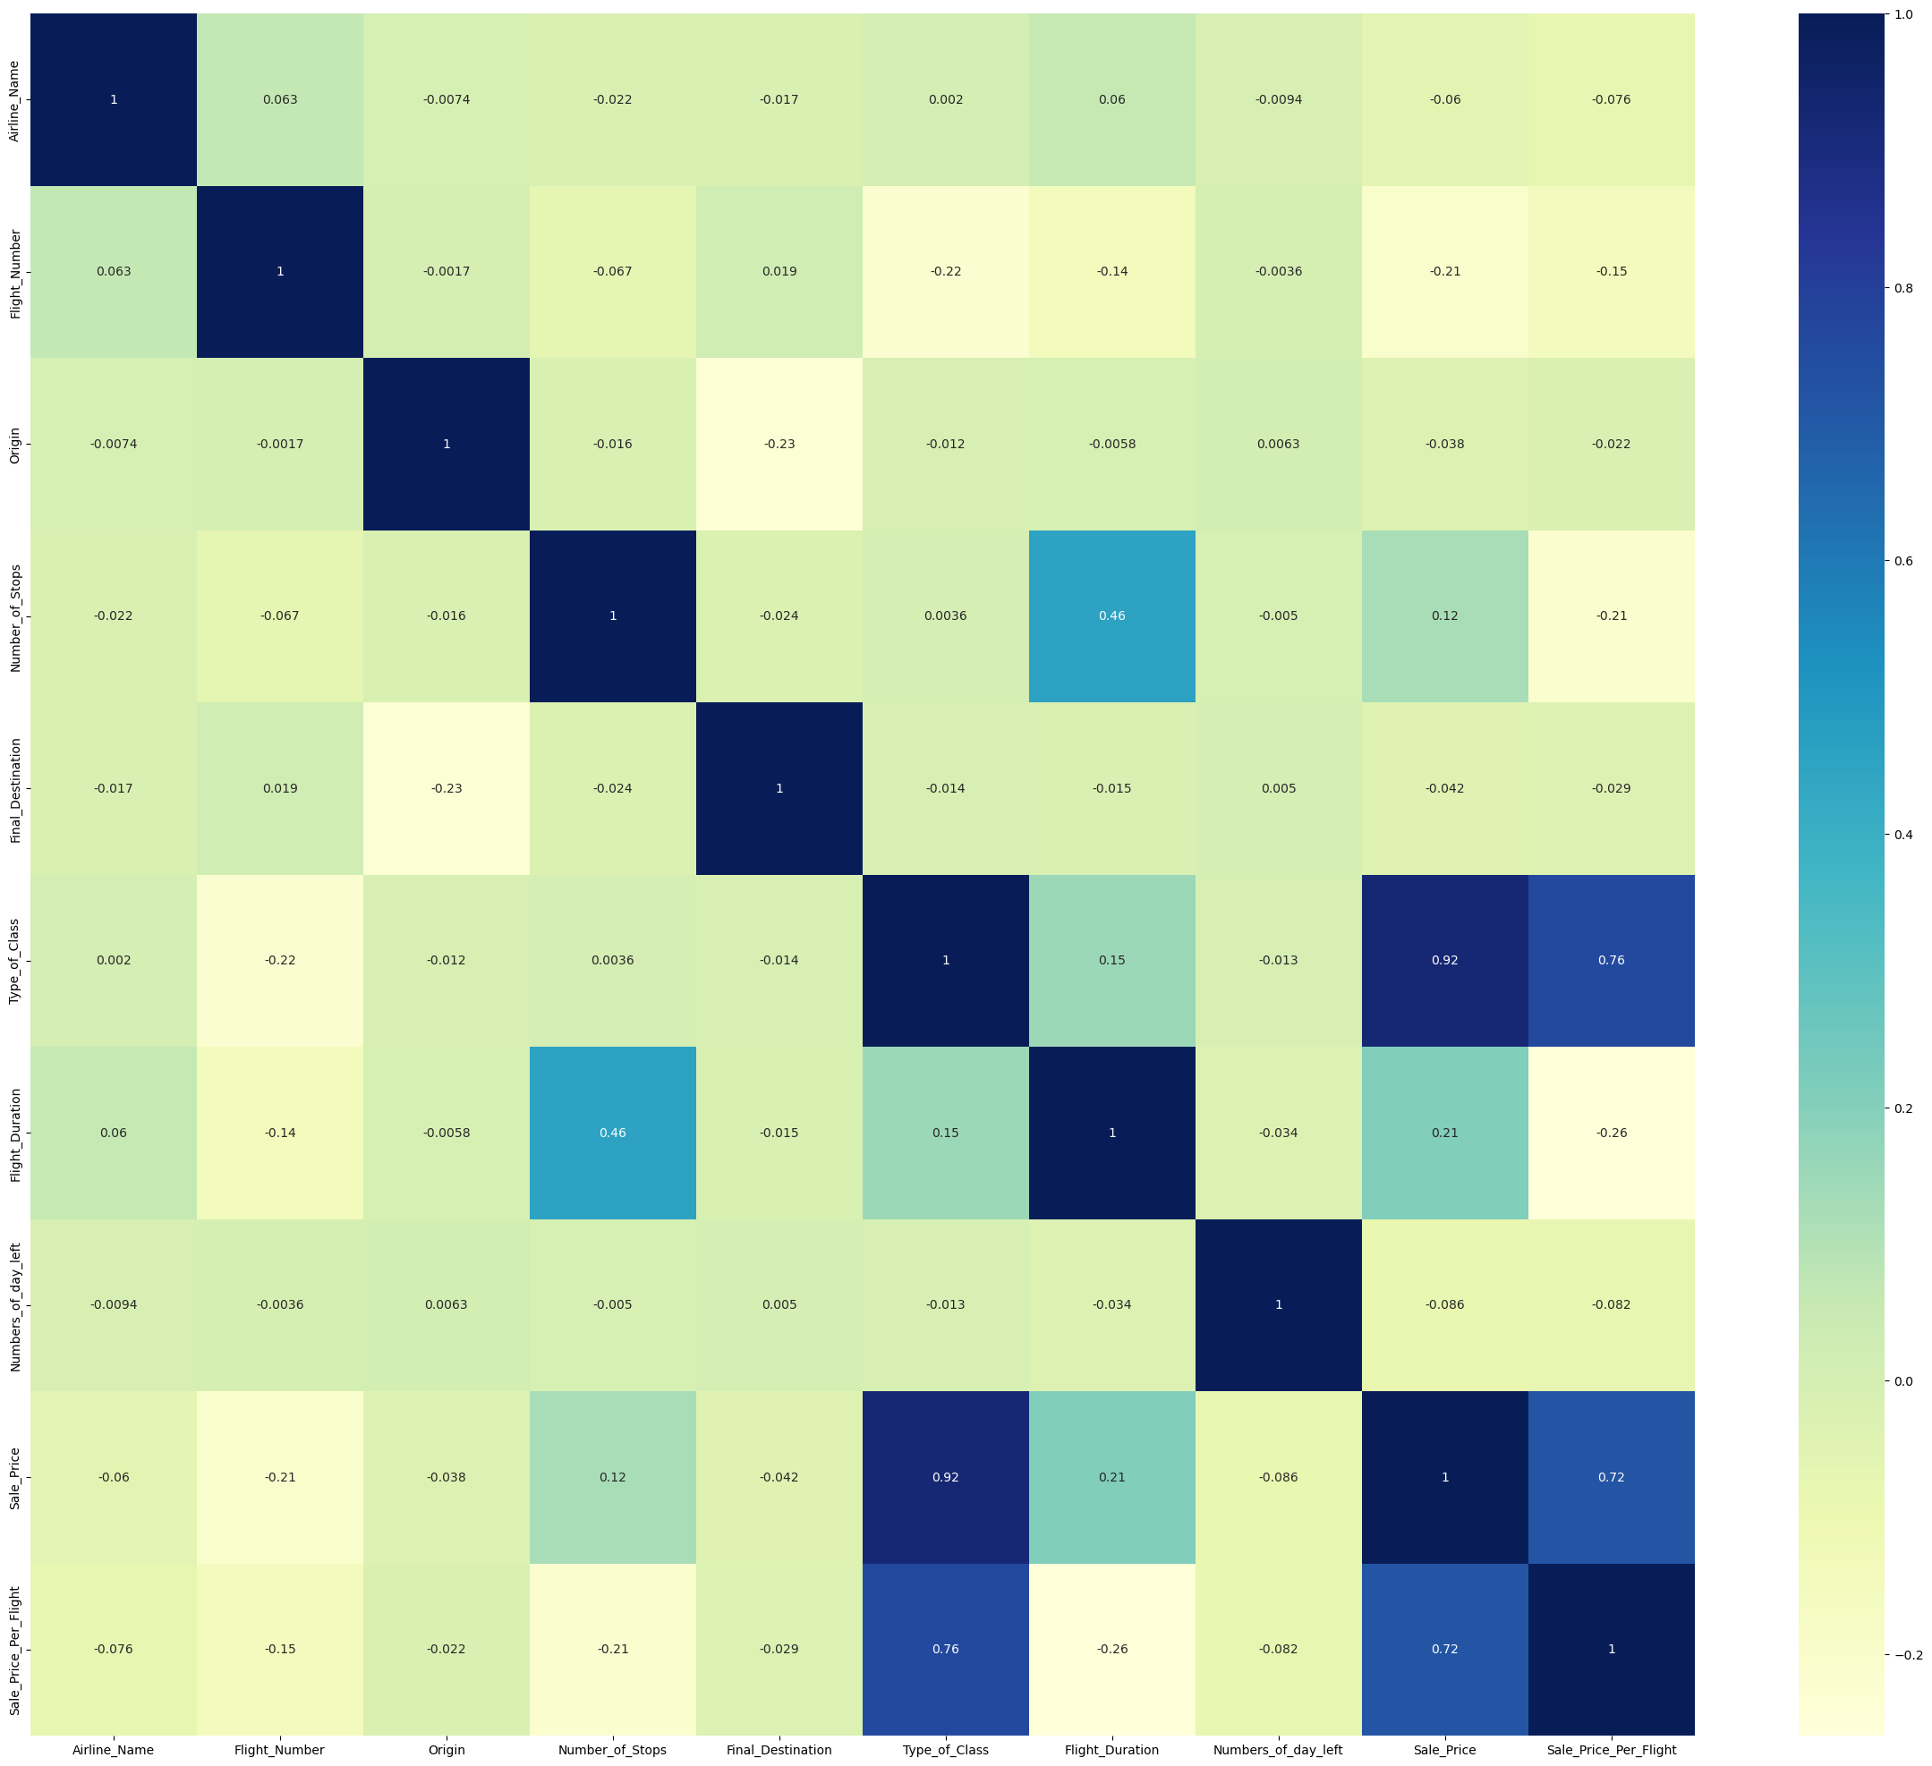
Steps to Analysis
● Data visual checks
● Detection of outliers
● Removal of Outliers
● Select Relevant Columns
● Convert Object to Integer
● Create Correlation Visualization
● Create Initial multiple Linear Regression
● Analyzed
● Reduce Initial Model
● Analyzed

Slide 10
Limitations
Python
Needs Programming Know-How
Delayed processing for Enormous Dataset
Multiple Linear Regression Model
Probability of Omission of Outcome

Slide 11
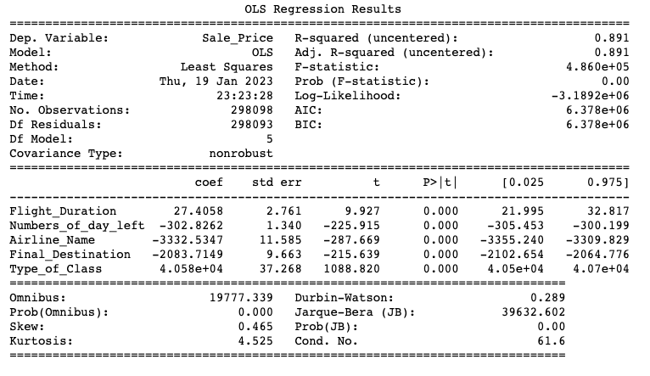
Analytically, 89% of results and can be explained consistently by the dataset Flight Duration in Relation to Sales Price as Shown is Statistically Significant to Conversions

Slide 12
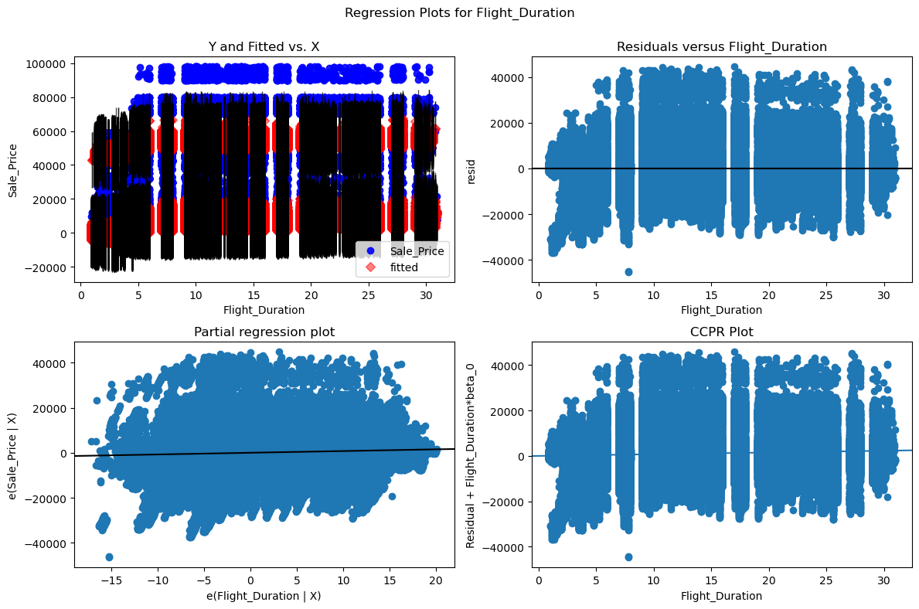
Residual vs. Predictor Plot for Flight Duration

Slide 13
Proposed Actions and Expected Benefits

Slide 14
Proposed Actions A. Collect More Data ● Increased record count ● Increased variables ● Adding other variables to the model
B. Review the sales prices of ticket in relation to duration by offering
● Media entertainment such as movie screens on passenger seats could help on long duration flights
● Option to find a flight with an available seat on another airline, customer can ask the first airline to transfer their ticket to the alternative airline – this practice could save them money by avoiding a fare increase and long duration.

Slide 15
Thank You Ibrahim Suleiman Master of Science, Data Analytics Student isuleim@my.wgu.edu

